Slide 1


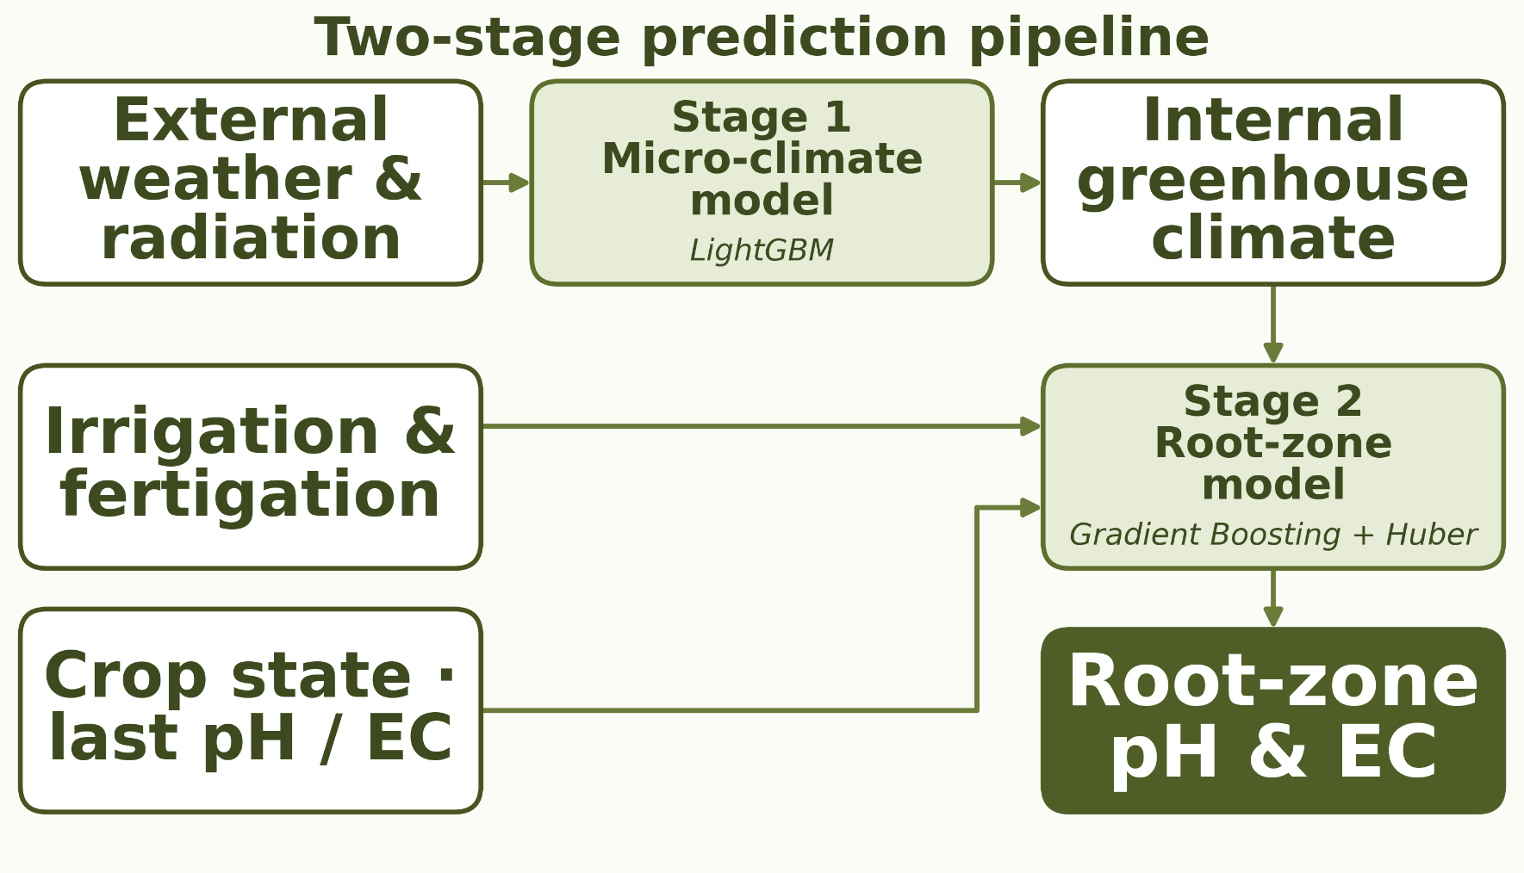
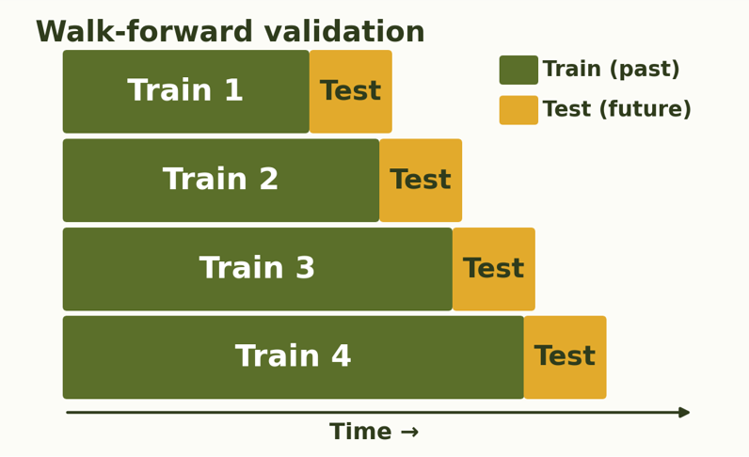
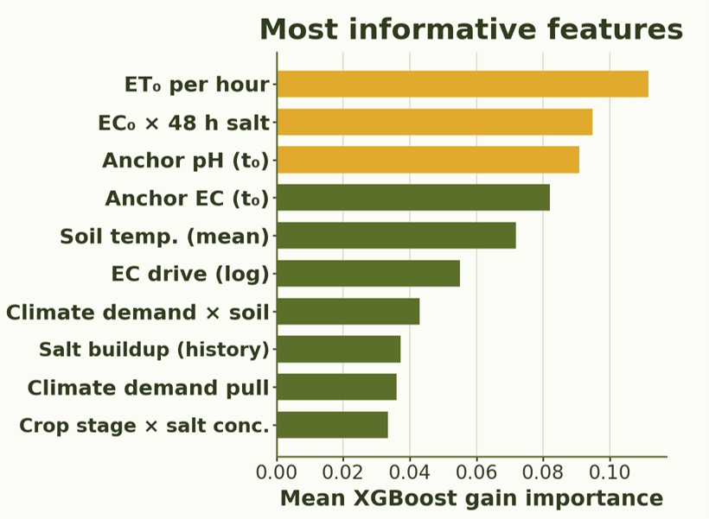
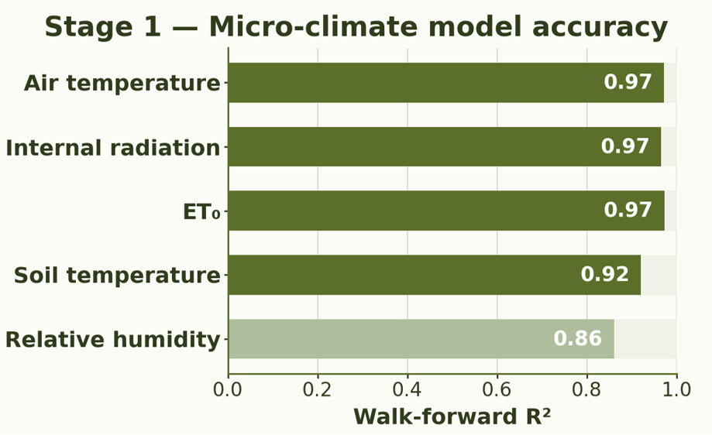
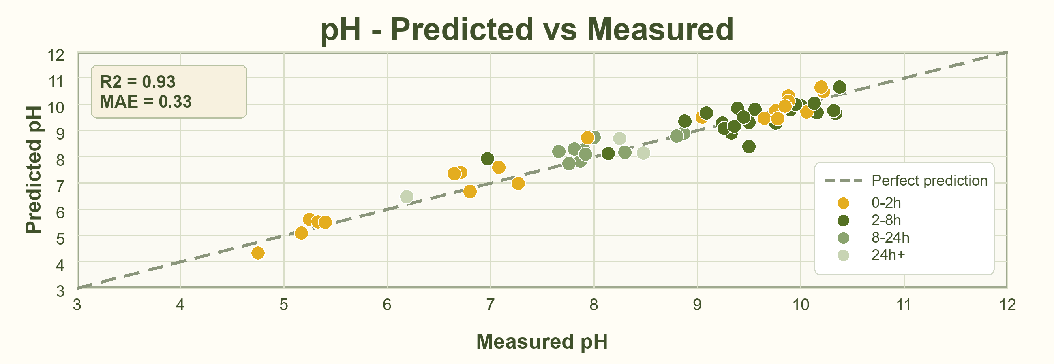
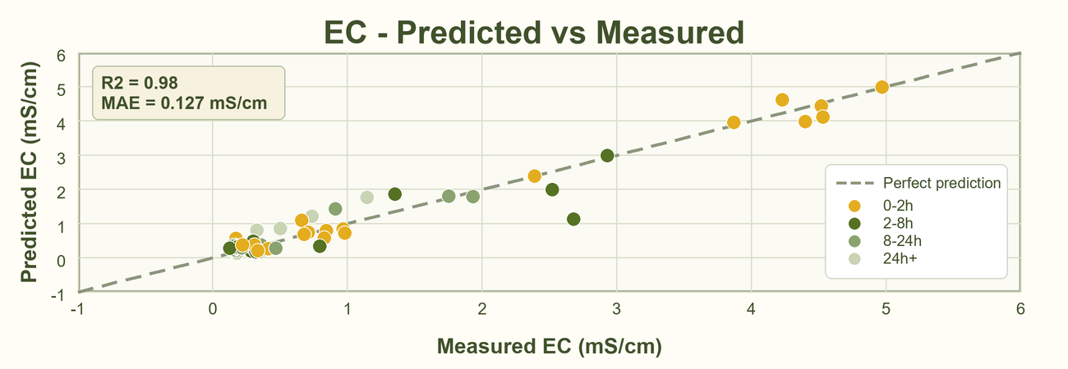
RUPPIN ACADEMIC CENTER · DEPARTMENT OF COMPUTER SCIENCE · AI & DATA SCIENCE SPECIALIZATION
Predictive Modeling of Root-Zone Variables Using Greenhouse Data
Students: Eden Eliyahu, Oren Chaushu
Supervisors: Dr. Avner Priel, Dr. Alaa Jamal
01
Motivation & Project Goal
Motivation
Project Goal
Root-zone pH and EC affect nutrient availability, salinity stress, and fertilizer efficiency. In greenhouses, they are typically monitored through accurate but infrequent manual samples, leaving gaps where changes from irrigation, fertigation, climate, and plant uptake may be missed. Predicting pH and EC from greenhouse data can give growers earlier insight, support faster corrections, and improve crop management.
▪ Develop a soft sensor that predicts future root-zone pH and EC from the latest measurement, forecasted climate, planned irrigation/fertigation and crop-state data.
▪ Estimate the t₀ → t₁ change so growers can test a planned irrigation/fertigation strategy, see expected future pH/EC values, and adjust before conditions drift.
02
Data
03
Method
04
Validation Strategy
16,682
109
20+
Two-stage prediction pipeline:
1. Forecast internal greenhouse micro-climate from external weather and radiation.
2. Predict t₀ → t₁ root-zone pH/EC change using climate, crop state and planned events.
▪ Walk-forward validation matches deployment: future pH/EC is predicted from past labels, forecasted climate and planned irrigation/fertigation.
▪ Future pH/EC labels are never used for training until after that sample becomes available.
10-min rows
pH / EC labels
input features
Sampling frequency by data source
Weather & radiation
Greenhouse climate
Irrigation / fertigation
Crop state
Manual pH / EC labels
May 29
Jul
Aug
Sep 21
16,682 dense rows
109 sparse labels
05
Algorithms & Model Choice
06
Micro-Climate Model
07
Challenges & Limitations
Hybrid model choice: Gradient Boosting captures nonlinear interactions for interpolation, while a Huber Regressor adds robustness to outliers and sharp pH/EC shifts during extreme conditions.
▪ Predicts internal greenhouse climate from external weather and radiation.
▪ Generates continuous climate inputs - temperature, RH, radiation, ET₀ and soil temperature - for the root-zone model.
Challenge
How we addressed it
Only 109 labels vs 16,682 rows
→
Modeled t₀ → t₁ intervals with accumulated and history features
Missing internal climate inputs
→
Micro-climate model filled greenhouse-condition gaps
Irregular sampling intervals
→
Added time-gap features and window-based aggregations
Low EC range sensitivity
→
Used log-transformed EC change and absolute-error metrics
Single season, one crop
→
Next step: validate across more seasons and crops
08
Root-zone Model Results - Walk-forward Test
0.33
0.93
62%
0.127
0.98
35%
pH MAE
pH R2
pH gain
EC MAE
EC R2
EC gain
09
Conclusions
Prediction value
Decision support platform
Soft-sensor feasibility
Improved over the baselines, showing pH/EC dynamics can be learned from greenhouse and crop data.
Built a user platform where growers upload data and receive future pH/EC predictions.
Sparse samples can still support useful root-zone forecasting when combined with dense greenhouse data.

